Slide 1
Ecommerce Churn Analysis

Slide 2
Business Goal
Data: It is a data for an online E-commerce company
Purpose: The company wants to know more about the customers who are going to churn and what approaches to do to retain company’s customers

Slide 3
Business challenge
Problem:
Customer churn, is when a company’s customers stop doing business with that company.
Businesses are very keen on measuring churn because keeping an existing customer is far less expensive than acquiring a new customer.

Slide 4


What Makes our churn analysis Matter to business?
.1. It can show product’s weaknesses and strengths.
By revealing patterns that indicate common motivators for customers to leave you, such as price sensitivity or poor product adoption.
2. Uncovers opportunities for better communication
Churn analysis reveals trends in customer behaviour at every touchpoint, as customers feel valued and appreciated by personalizing the engagement through the communication channels that your customers prefer.

Slide 5


3. Helps you predict and thus reduce future churn
Our Churn analysis involves analyzing historical customer data to make churn prediction possible, That means you can be proactive in your approach and prioritize improving retention when you notice the red flags indicative of churn.
4. Acts as your secret weapon during a crisis
Churn analysis is beneficial at all times, but even more so in a downturn or recession.

Slide 6
The validity of our Data
The first column of the data was just an iteration for the number of records in our data so we dropped it
After checking for duplicates, we found (11260) duplicated records which we also removed from our data
Categorical Data
Numerical Data
1- we have problem with gender column as there are 4 unique values however the possible values are male and female only
2- The problem with Payment Mode column was that some categories present in different forms such as [Credit card : CC – Cash on delivery : COD)
3- The problem with Preferred Login Device that
we found a category named ( 0 ) which means
nothing.
1- from churn column summary we can see that 75% of the data is equal to zero which means that at least 75 percent of our customers are staying with the company
2- the minimum of the Tenure column is -10000 which is not right
3- Max of satisfaction score column doesn't feel right

Slide 7

The scope of the analysis
Our analysis bases on exploring and studying clients’ behaviour to draw insights that will help the company to take actions that will increase clients’ retention.
We analyse many features and communication channels between the client and the company to determine what factors may be the main reason behind customer churn.

Slide 8
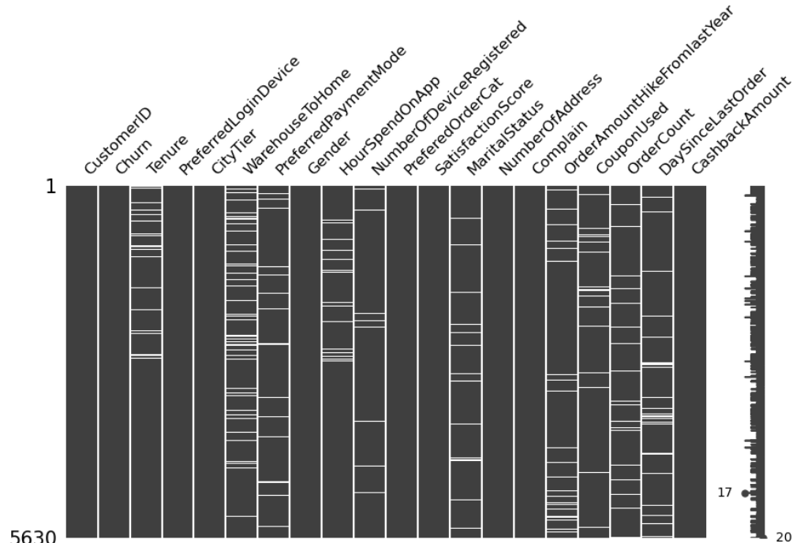
Null values handling:
-Large number of null values present as shown in Fig1.
-From the pattern after sorting the data by different cols, we
found that our nulls are missing at random (MAR).
-So, we found that the best approach to handle these missing
Values is by the use of imputing techniques.
-We filled the numerical data nulls by using Iterative Imputer, and we filled the null values for categorical columns by using the mode of these columns.
Outliers handling:
-We performed a 90% Winsorization on the tenure column to set all outliers to a specified percentile of the data, which means that we set the data below the 5th percentile to equal the value of 5th percentile and the data above the 95th percentile to equal the value of 95th.
-For satisfaction score column, we found a value = 589314 which is obviously a typo error so we assumed that this value equal to 3 as it is a passive value that wouldn’t affect the net promoter score (nps).

Slide 9
We performed our analysis from many prospectives and using some different criteria:
Criterion 1:
By looking at the number of days since last order for each client we could segment our customers into 6 categories by number of days and we performed further analysis on customers whose last order was 15 days ago based on different criteria [Gender – City – Order category ]
Insights:
1) After analysing the customers who haven’t made a purchase 15 days ago, we found that 61% of them are males and 39% are females
2) 74% of them are from city Tier 1 and 26% of them are from city Tier 3
3) Most common order categories in which those customers are interested are Grocery
4) Only 26% of them had complaints over the last month, so maybe it doesn’t affect their buying behaviour.
5) Over 90% of them uses mobile phones.

Slide 10

Actions based on criterion 1:
The company may send promoting e-mails or SMSs to those customers to encourage them to make orders as those customers may be at risk to churn
It will be more effective if these campaigns were personalized more toward males.
The company should focus it’s action on City tier 1 and 3 specially City tier 1
The promoting e-mails and SMSs should involve discounts on Groceries and Fashion specially the Grocery category
Following up upon their complains and making sure that
all of their complains are resolved.

Slide 11
Criterion 2:
We tried to understand customers’ behaviour from a demographic prospective as we analysed male and female data separately in order to find any difference between them to know if it will be effective to target certain gender in company’s marketing campaigns.
It was analysed based on multiple criteria such as (Preferred Login Device – Preferred payment mode – Preferred order categories – Number of addresses – Hours spent on App) to help us highlight the difference in behaviour between males’ and females’ if exists !!
Insights:
1. Rate of churn in males is 17.7% while the rate of churn in females is 15.4%.
2. Both prefer to login on Mobile Phone more.
3. The first payment method being Debit Cards for both genders, then Credit Cards comes next.
4. The preferred ordered Category is Mobile Phones, while for females it is Laptop & Accessory.
5. It appears that the order count for Married Couples are the largest sector for both males and females.

Slide 12

Actions:
- From our analysis on gender, we can say that there is no difference between males and females in their behaviour, but The number of churned males are larger than the churned females, However the total number of males is also larger than females .
- Because of that, it is possible that no of churned males are greater than churned females.
- So, we have to check the rate by measuring churned male over the total number of males only and the same for female.
- After checking we found that churn rate of male (17.73) is slightly higher than the churn rate of female (15.49).
- So, our recommendations to the company to generalize their actions without considering the gender most of the time, but some campaigns can be more toward males as they are slightly more potential to churn than females.

Slide 13
Criterion 3:
Here we analysed all of the features that we have in the data to study the behaviour of our customers effectively and to determine which ones of these features act as key indicators for customers churn.
Insights:
After performing some statistical analysis between each one of our features and churn column, we found that all of the features act as key indicators and potential reason for customer churn except for the following [ Coupon used - Order Amount Hike From last Year & Hours spent on App ]
City Tier: Where City Tier 3 has the highest CR ~21%
Marital Status: Where Single customers are the most churned customers with ~27% CR
Login Device: Computer Users are more likely to churn than mobile users 20% CR
Payment Mode: Cash on Delivery and E wallet users are more likely to churn
Order Category: Mobile category is the most preferred category with 27% CR

Slide 14
Customers with low cashback amount from last month tends to churn more than customers with high cashback amount.
Tenure: Recent customers are more welling to churn as the highest churn rate was shown in the low tenure category (0 to 5)
Complain: Customers that raised complains in the past month have higher churn rate (~32%) compared to who didn’t.
Satisfaction Score: Customers with 5 satisfaction score have the highest churn rate ~23%.
Actions:
1. Making promoting messages and ads computer users friendly
2. Giving more attention to the process of complains handling
3. Increase cashback amounts and offer cashbacks to larger number of customers
4. Offering rewards and discounts upon placing orders specially for the new customers

Slide 15

Criterion 4:
We also included the distance between warehouse and clients’ homes in our analysis to determine if it has an influence on the complaints or not, as it will be beneficial for the company to know if there is a problem in the delivery time or not.
Insights:
After statistically analysing warehouse column with complaints, we conclude that there is significant difference in the mean Warehouse To Home distance between customers who complain and those who do not complain.
The correlation between Warehouse To Home distance and complain is
positive but weak and not noticeable
Actions:
Making calls to track complaints and understand the main reason behind them

Slide 16
ML-Models
Encoding nominal categorical variables using one hot encoding:
- One-hot encoding is a technique used in machine learning to convert categorical data into numerical data that can be used in various algorithms.
- In one-hot encoding, each categorical variable is converted into a binary vector of size n, where n is the number of categories. The vector contains all zeros except for the position corresponding to the category, which is set to 1.
- We used this technique to encode our categorical data in order to give all categories per each column the same weight as some other techniques can make some categories more preferable than others which is not suitable for our analysis.

Slide 17
Splitting our data:
- We split our data into train, test and validation using test size 0.3
- We used a constant random state in order to ensure the reproducibility of the randomization
- Applying stratified sampling to ensure that the proportion of classes in the original dataset is preserved in both the training and test sets since our data set is imbalanced.
Metric to test the performance of our model:
We used f1 score as
1. we could not use accuracy since the classes are imbalanced . This is because accuracy can be misleading when the classes are imbalanced , since a high accuracy score can be achieved simply by predicting the majority class.
2. f1-score would be a good metric because we want to balance both precision and recall Precision : “reducing false positive”; predicting a customer will churn when they actually won’t
REACLL : “ Reducing false negative “ ; predicting customer won’t churn when they actually will

Slide 18
Model modification by tunning hyperparameters:
We used randomized search, which is a technique that helps optimize the performance of a machine learning model. It works by randomly selecting combinations of hyperparameters from a defined search space and evaluating the model’s performance using cross-validation.
Models:
We tried three models (Decision tree – Random forest – Ada Boost classifier).
We decided to go with Ada Boost classifier since it gives as the best f1-score.

Slide 19
Thanks
Team 5:
Omar Hany Mohamed Mohamed
Sandra Ezzat Rezk Moses
Mariam Alaa Eltoukhy
Ahmed Yasser Mohammed

